Slide 1

Rotary
Global Grant
Scholarships

Slide 2
Ambassadorial Scholarships
1947 - 2012
Cultural Scholarships: Short-term language, cultural, and vocational scholarships for undergraduates, graduates, and professionals
Academic Scholarships:
One- and two-year scholarships for undergraduates and graduates
Global Grant
Scholarships
2013 – present
Academic Scholarships:
One- and two-year scholarships for graduate students

Slide 3
Our District supports Global Grant Scholarships
Ambassadorial Scholars, 1947 - 2012
187 scholars
Global Grant Scholars, 2013 - present
8 scholars
Our District uses DDF funds to cover 56% of the cost of the scholarship, while the Rotary World Fund covers 44%.
Notes:
Many of the 187 Ambassadorial scholars were 3- and 6-month language and cultural programs.
Global Scholars:
2021 – Faith Leslie
2022 – Allison Potter
2023 – Kiara Hunter
2024 – Megan Curling
2024 – Ava de Bruin
2024 – Nazaneen Shokri
2025 – Holly Miranda
2026 – Emily Ecker

Slide 4
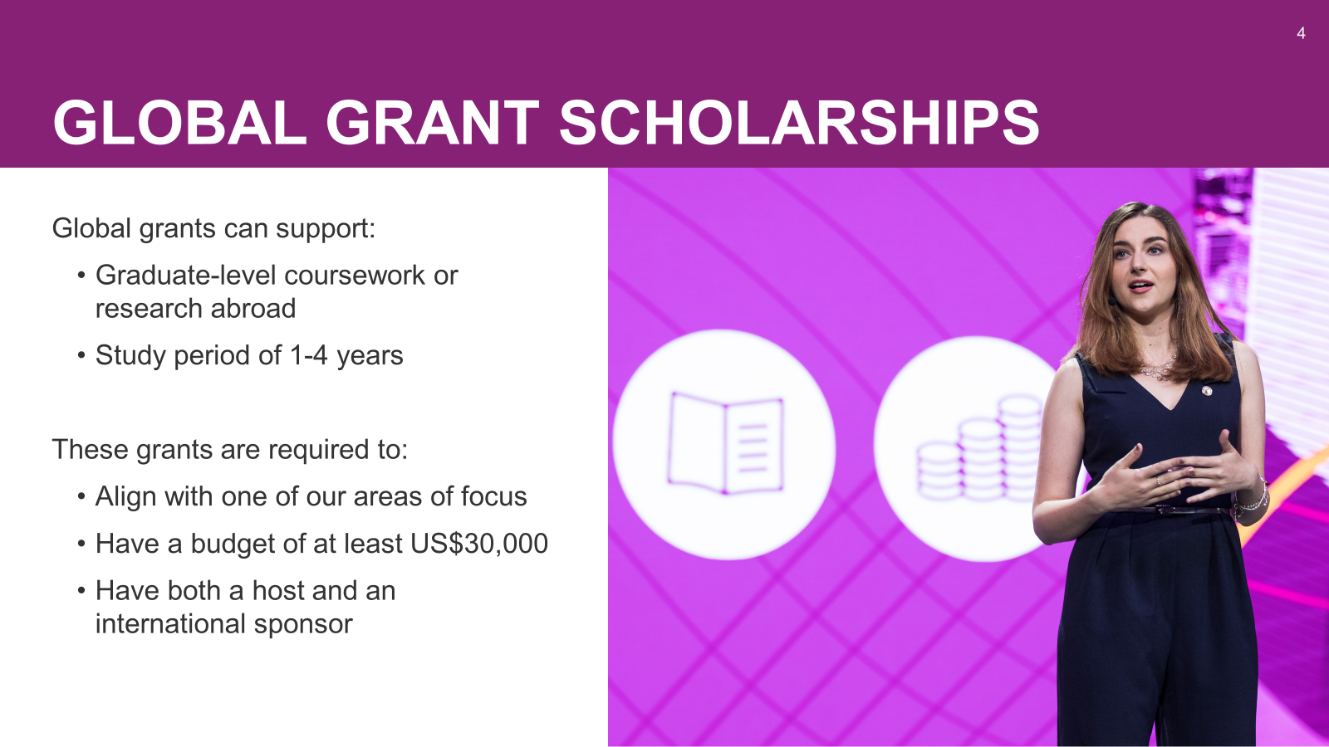
Notes:
Global scholarships support future leaders who commit to gaining expertise in one of Rotary’s seven areas of focus. The award of $30,000 can be spread over 1 to 4 years.
The scholar must study at a University outside of their home country.
Global grant scholars have an international sponsor - a club in the scholar’s home district, plus a host sponsor - a club in the country where the scholar will be studying.
Our District Governors have strongly supported this program in the past and have used District funds for the District portion of the grant, rather than requiring clubs to raise the funds.
I hope that the upcoming DGs continue this support.

Slide 5
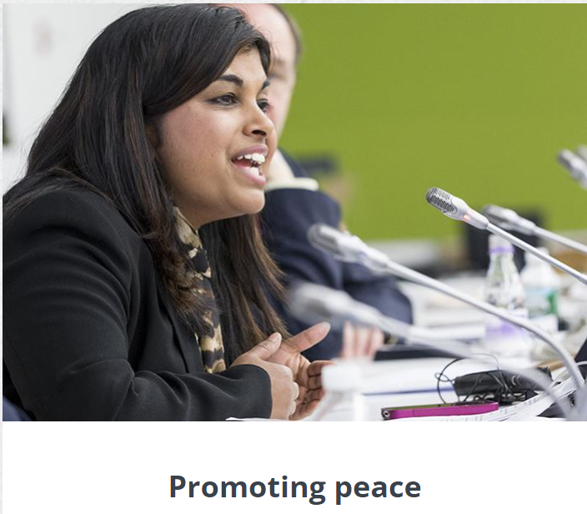
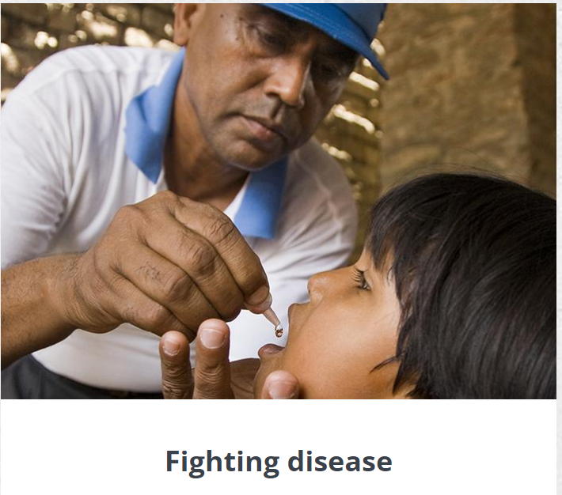

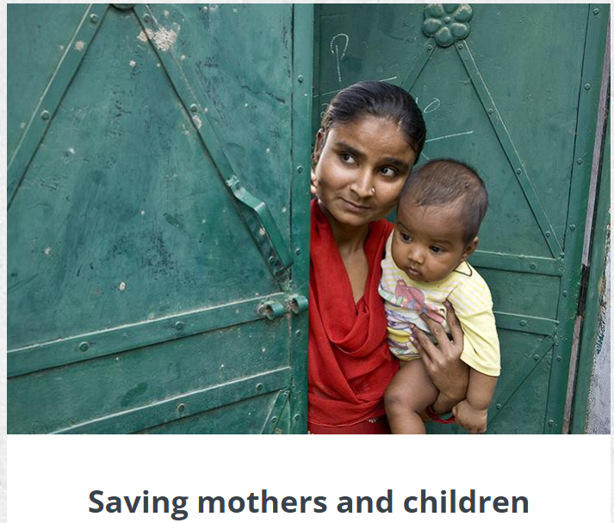



Rotary’s
Areas of Focus:
Promoting peace
Fighting disease
Providing clean water
Saving mothers and children
Supporting education
Growing local economies
Protecting the environment
Notes:
Previously, Ambassadorial scholarships were much more broad-based – language, cultural, and vocational studies were allowed.
Global Scholarship grants must now support studies in one of Rotary’s seven areas of focus.

Slide 6
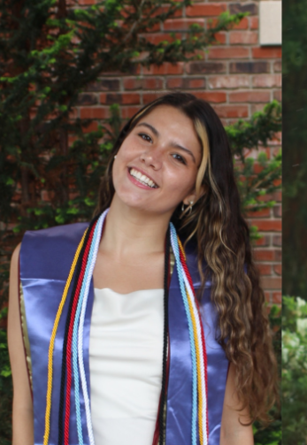
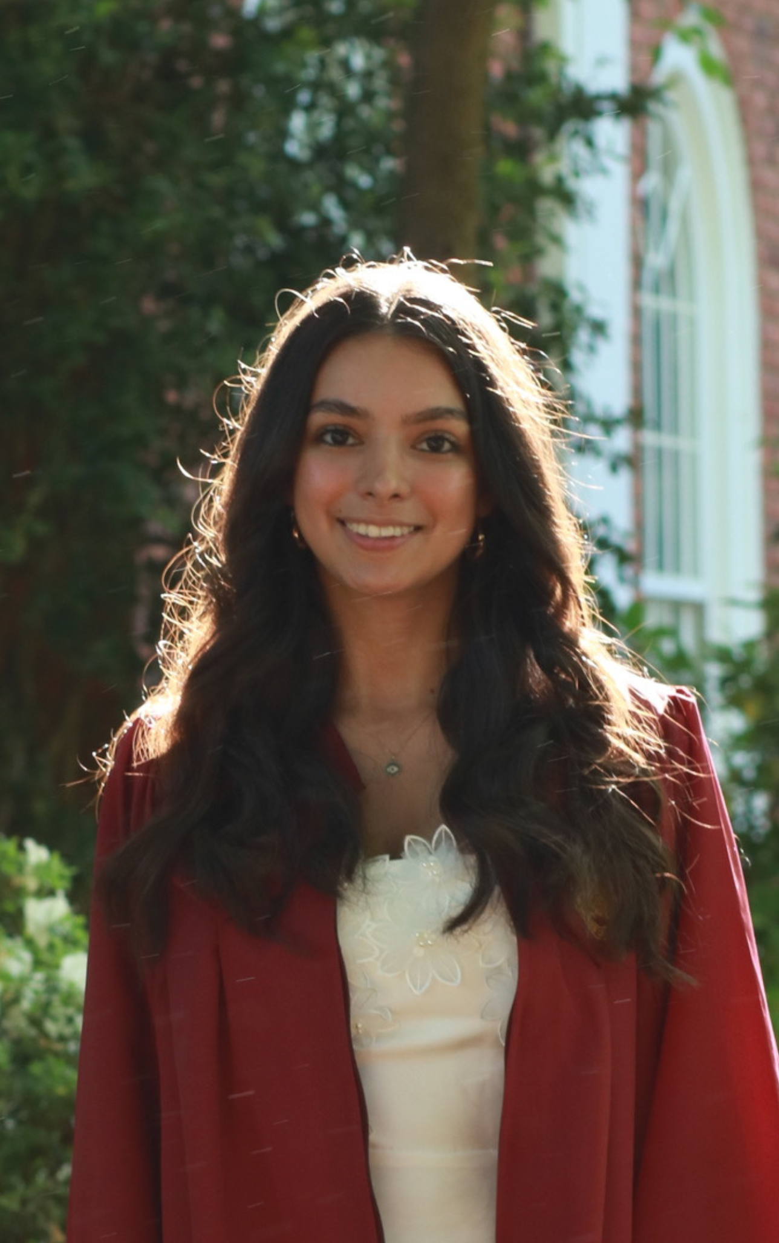
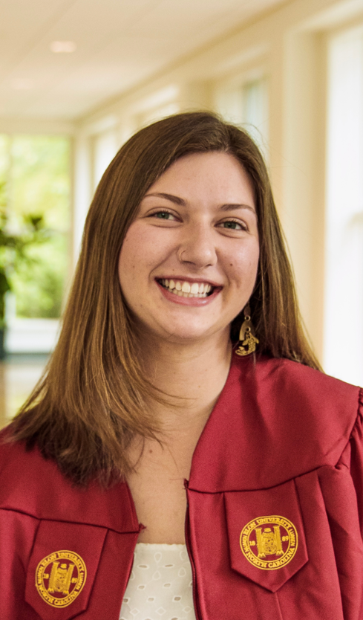

Ava de Bruin
2024-25 Scholar
London School
Of Economics
London, England
Nazaneen Shokri
2024-25 Scholar
University College London
London, England
Notes:
Normally our District awards one Global Scholarship. In 2024, our District funded three Global Scholars.
2024 scholar Ava de Bruin graduated this fall with a Masters in Health and International Development. She is currently working for a non-profit in Ireland. She hopes to work on gender-based bias in health accessibility.
2024 scholar Nazaneen Shokri graduated this fall with a Masters in Women’s Health. She will be attending medical school in the fall, in her pursuit to become pediatrician for underserved women and children.
2024-26 scholar Megan Curling graduated earlier this year with a Masters in Public Health. She is currently looking to work with a nonprofit in Southeast Asia, such as the Center for Creative Initiatives in Health and Population (CCIHP).

Slide 7
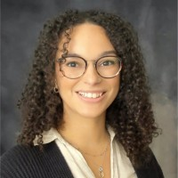
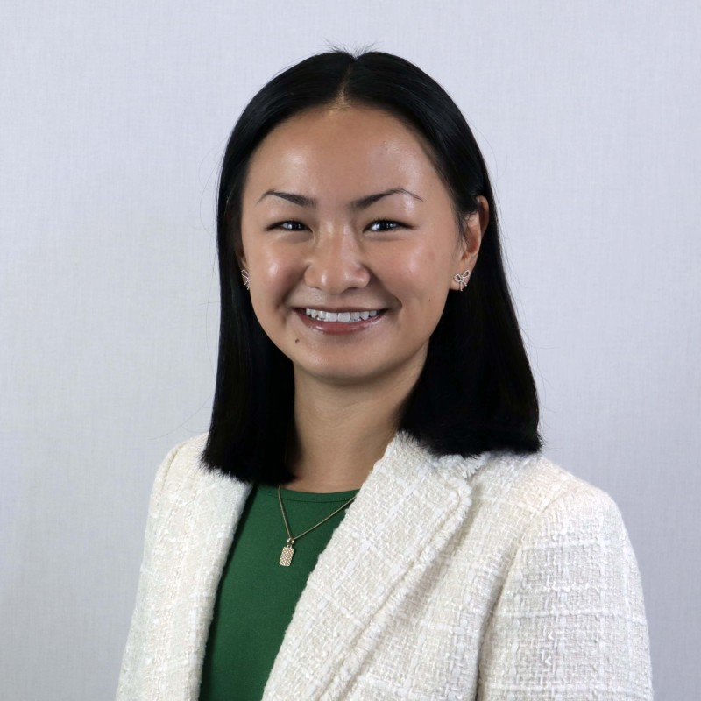
Holly Miranda
2025-26 Scholar
National Taiwan University
Taipei, Taiwan
Notes:
This Fall, Holly started her MS program in Global Health. She hopes to return to the CDC where she worked for 3 years prior to entering graduate school.
Emily will start her her MS program in Food Securities. She hopes to work with NGOs in sub-Saharan Africa, focusing on food insecurity.

Slide 8
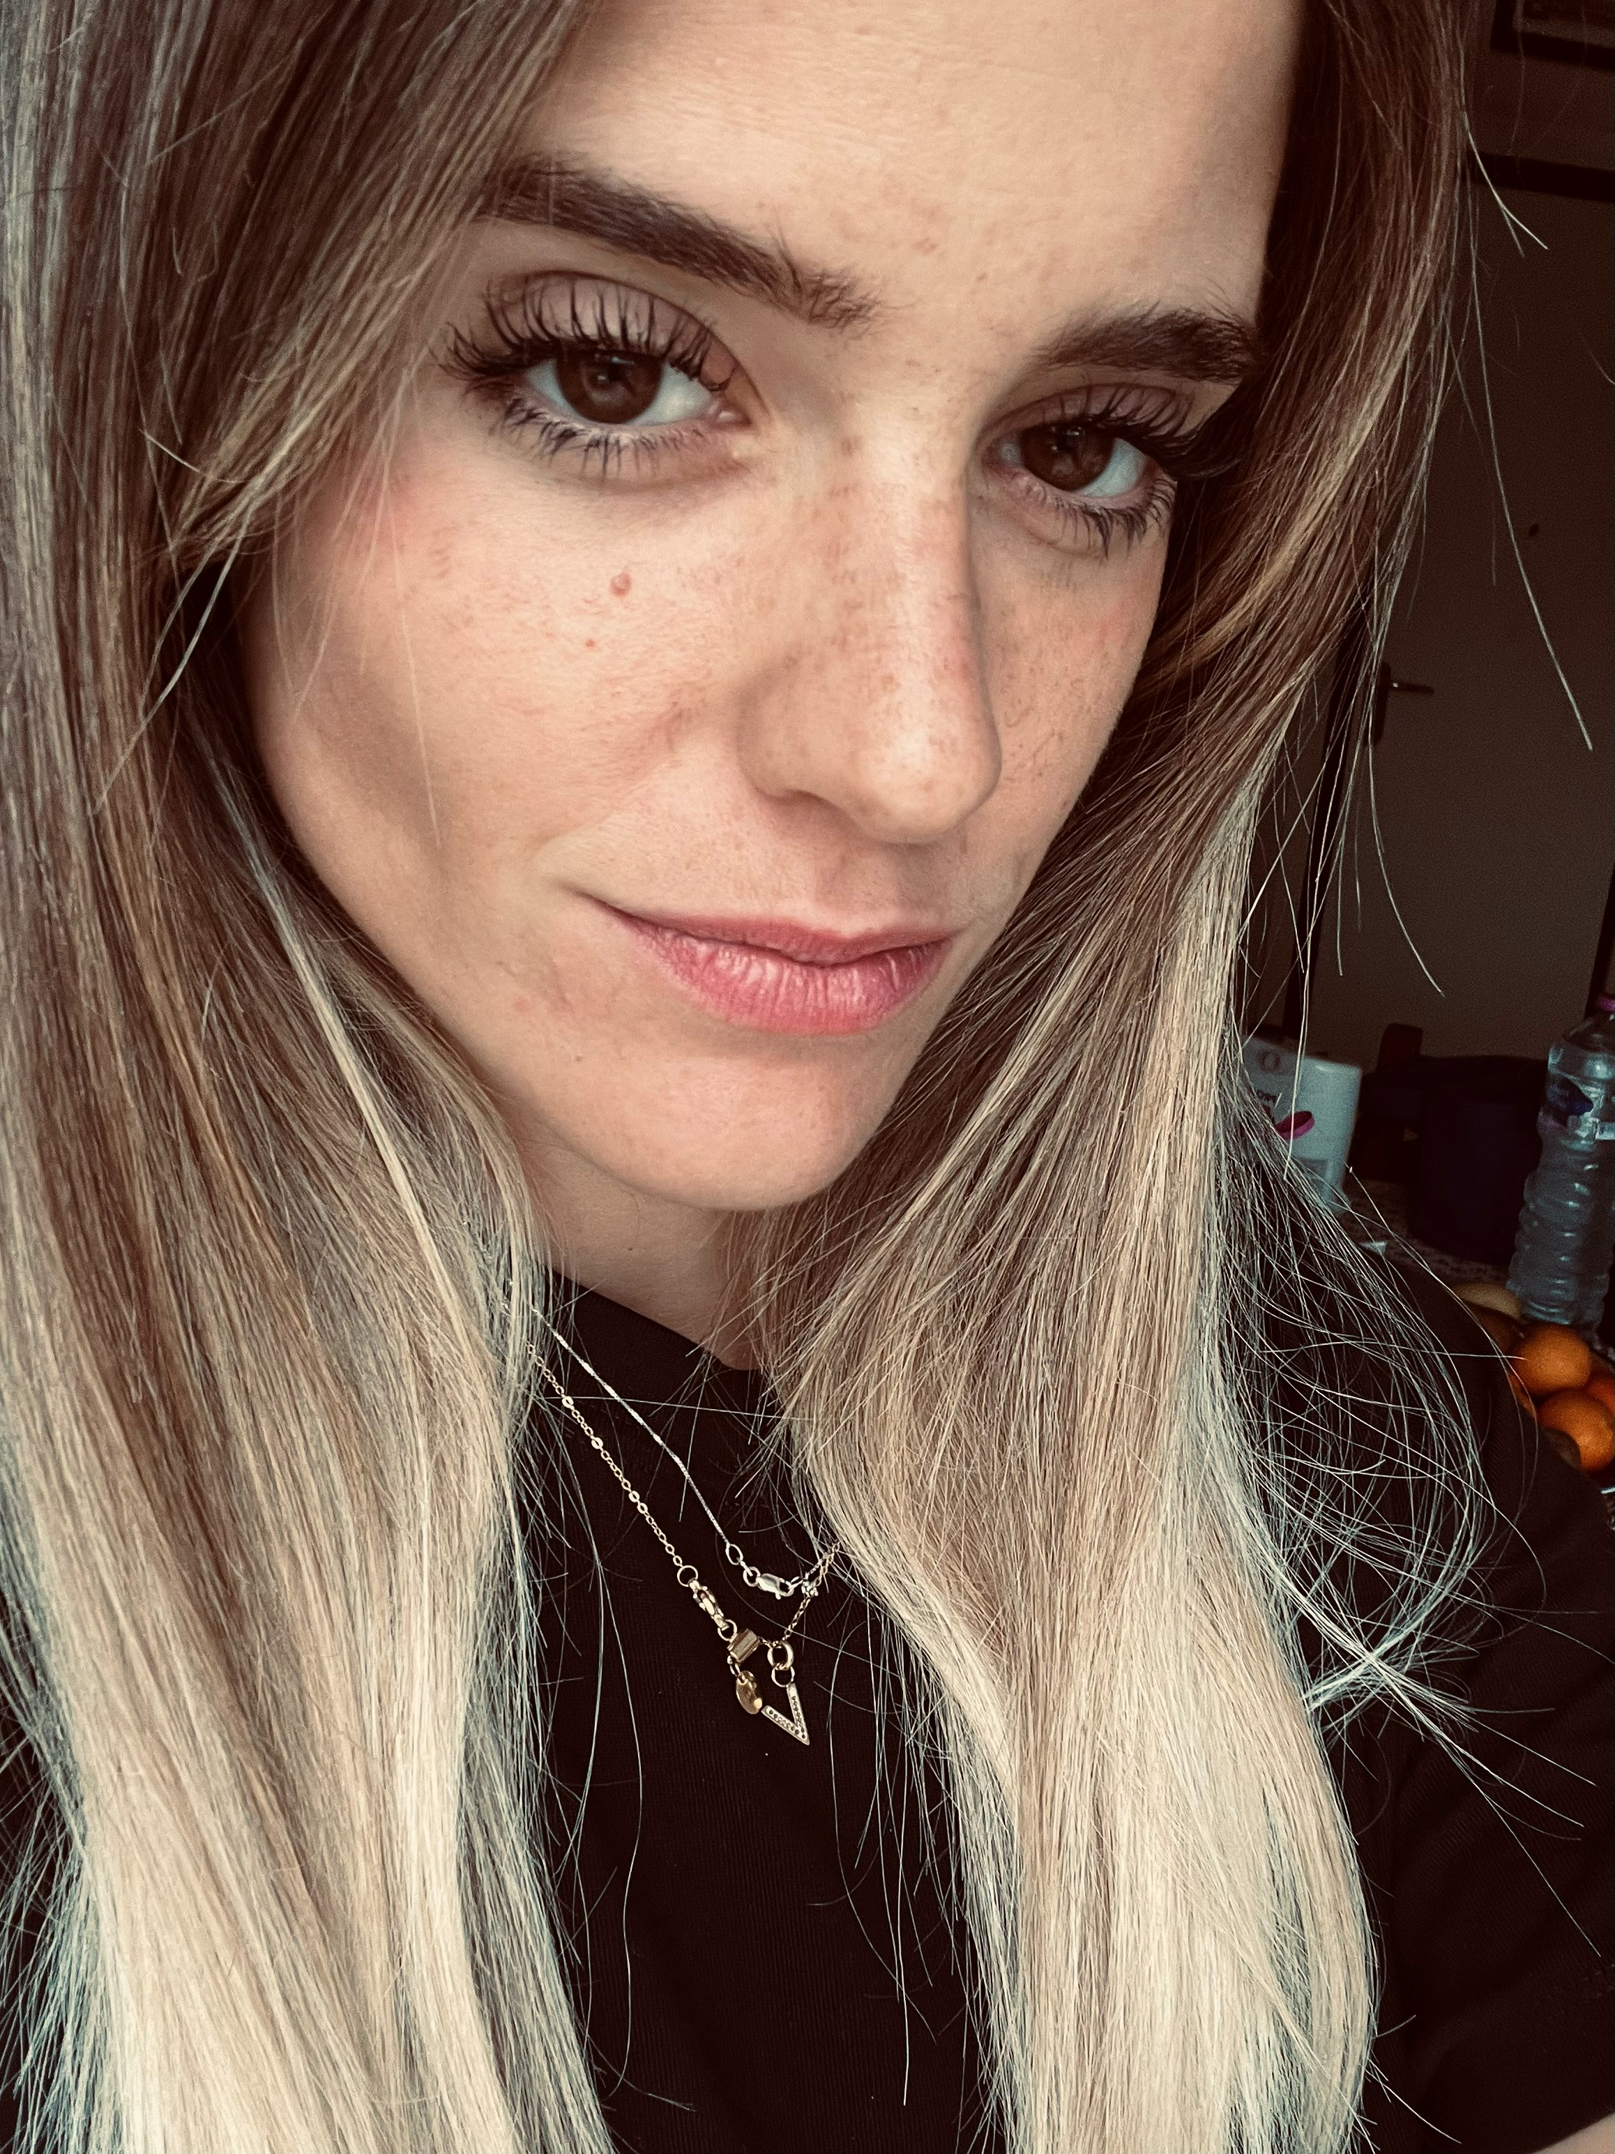
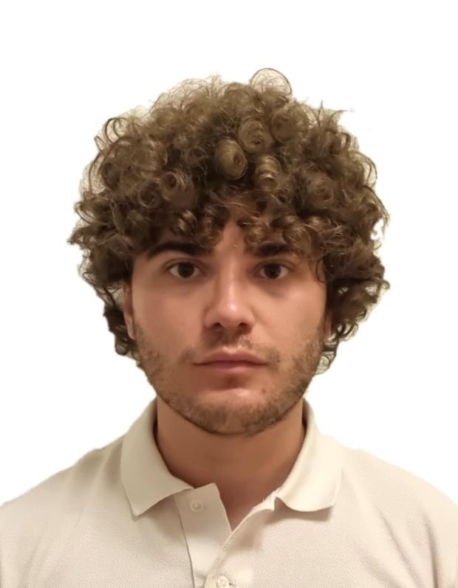
Victoria Marchetti
2025-26 Scholar
Wake Forest Univ.
Niccolo Melandri
2025-26 Scholar
Wake Forest Univ.
Notes:
Global Scholars can also be inbound, to study here in the US. There is no cost to our District for incoming scholars, as all costs are paid by the sponsoring District and the Rotary Foundation.
The Clemmons club was to be the host club for these students.
These two students, from the University of Bologna, were planning to do post-graduate studies and experiments in biomechanics in the Wake Forest School of Medicine. Their programs of study focused on sensory integration capabilities and the development of new sensory rehabilitation protocols.
Unfortunately, their plans changed at the last minute, and they were not able to come to the US.

Slide 9
“The Ambassadorial scholarship helped me figure out my interest in environmental science could also help solve problems around the world. It helped me form goals around my interests that ultimately lead me to my current job and career as an environmental science educator.
I also learned how to properly partner with local communities to help them reach their own goals. It was truly a life-changing experience for me. The Rotary projects I volunteered with on the ground in Cape Town are some of my favorite memories and I learned so much about community service from the Rotarians I worked with.
Those lessons are still with me today, as I have been involved with Rotary at various times since my scholarship.”
Chrissy Orangio, 2009 Ambassadorial Scholar

Slide 10
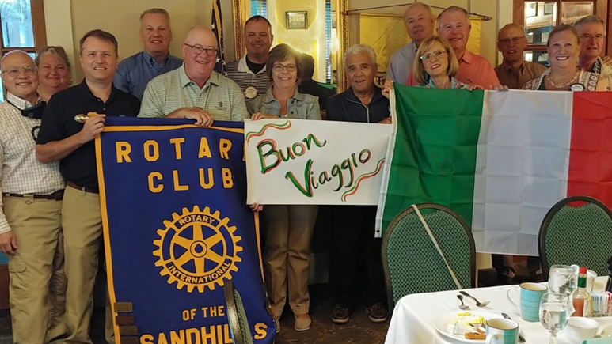
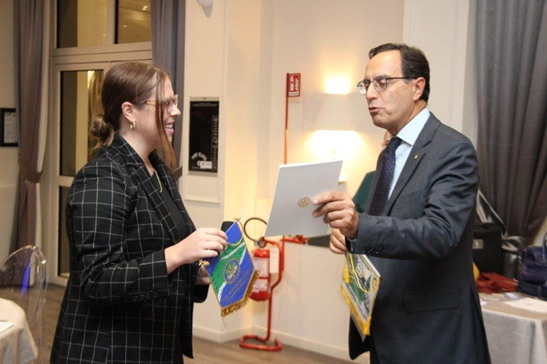
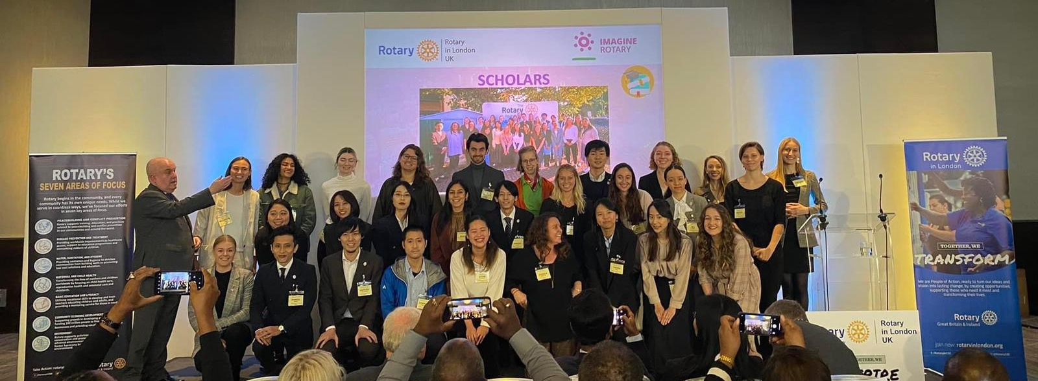
Notes:
What can all this mean for you and your club?
Just like other Global Grants, there is a partnership between a Club in our District and a Club in the District of the foreign university that the scholar will be attending. It’s a great way to build a friendship with a young person whom we anticipate will effect positive change in our world. It also opens a channel to a partner District and club overseas.
Remember the sponsoring club does not have to help fund the scholarship.

Slide 11
What can you do to help?
Work your contacts at local universities to increase their involvement with this program.
Encourage talented students to consider applying.
Have your club volunteer to serve as a sponsoring club.
Notes:
Although scholarship applications and information are sent to seven local universities, we have only received applications from students at three universities: High Point University, UNC Greensboro, and Elon University.
Over 90% of our applicants have been female. Help us find broaden our applicant base.
Consider having your club serve as a host club. Interact with our global scholars and watch them as they complete their graduate studies and head out to make the world a better place.
You don’t have to be a big club to sponsor a Global Scholar. The Sandhills and Graham clubs partnered to sponsor our 2021-2022 scholar Faith Leslie. The Alamance club sponsored 2022-2023 scholar Allison Potter. The Downtown Greensboro Club sponsored Kiara Hunter, our 2023-2024 scholar. The Global Trekkers club sponsored 2024-25 scholar Nazaneen Shokri.
I have had the pleasure of serving on the interview committee for our District’s Global Scholarships. Our Scholars are very impressive young graduates. They’ve done research projects overseas, had senior projects published in peer-reviewed journals, and one scholar served as one of two student representatives on their University’s Board of Trustees.
Interested in serving on the interview committee?

Slide 12
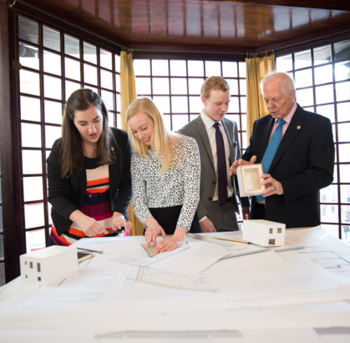
For further information:
Russell Guy
russguy1982@gmail.com
(336) 213-0190
Notes:
Any questions?

